Slide 1

Exploratory Data Analysis
G2M Case Study
14-Nov-2022

Slide 2
Agenda
Problem Statement
Data Exploration
Areas to Investigate
Analysis
Recommendations

Slide 3
Problem Statement
XYZ is a private equity firm in US. Due to remarkable growth in the Cab Industry in last few years and multiple key players in the market, it is planning for an investment in Cab industry.
• Objective : Provide actionable insights to help XYZ firm in identifying the right company for making investment.

Slide 4
Data Exploration
4 csv data set
Cab_Data – transaction for 2 cab companies
Customer_ID – customer’s demographic details
Transaction_ID – transaction to customer mapping and payment mode
City – List of US cities, population and number of cab users
Final Data
Number of rows: 355,032
Number of columns: 14
Time frame: 2016-01-31 to 2018-12-31

Slide 5
Areas to Investigate
Number of cab users change over year
Cab profit change over year
Cost Efficiency of cab
Average Profit/Users over year
Highest Profit/User cities

Slide 6
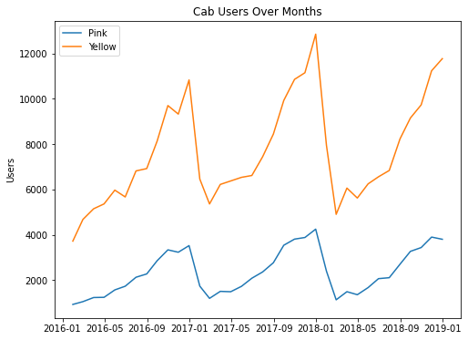
User Analysis
There is a seasonal trend in cab users across a year: cab users tend to increase as throughout a year and reach its peak in December/January
Yellow cab had significantly more customers than Pink cab in the past three years

Slide 7
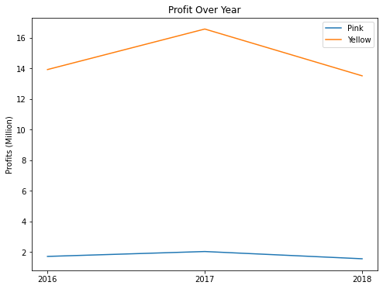
Profit Analysis
Both companies made more profit in 2017
Yellow Cab made more profit overall than Pink Cab

Slide 8
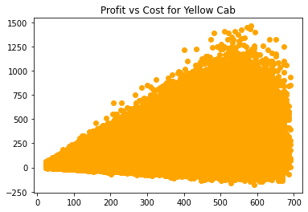
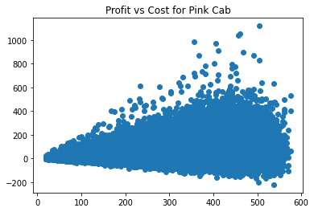
Profit Analysis
There isn’t a clear linear relationship between profit and cost, but we can see that in general there are more Yellow Cabs that are able to make more profit as cost increases

Slide 9
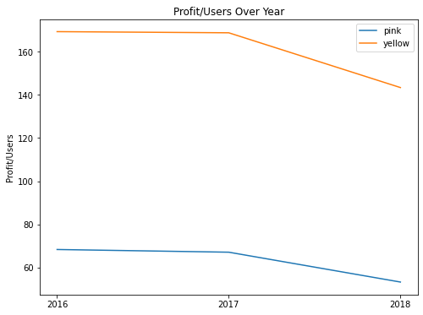
Profit Analysis
Both companies made less profit/user in 2018
Yellow Cab on average made more profit/user than Pink Cab

Slide 10
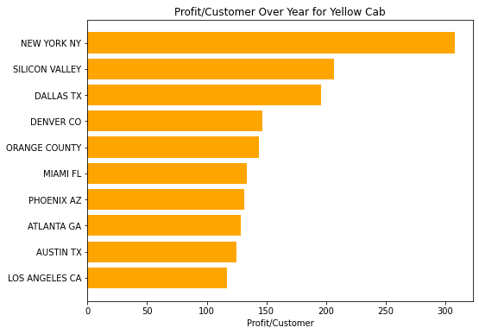
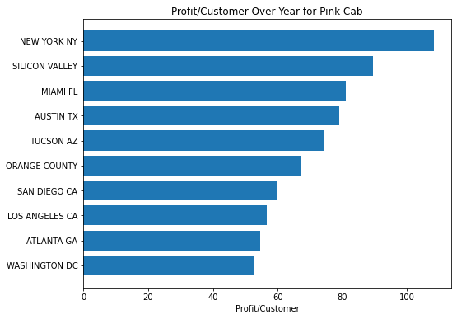
Profit Analysis
For both cab companies, New York and Silicon Valley both have a higher profit/customer

Slide 11
Recommendations
According to the given data, we would recommend XYZ company to invest in the Yellow Cab as opposed to the Pink Cab for the following reason:
More users
Higher overall profit
Higher profit/users
In addition, we would recommend XYZ companies to invest more in cities such as New York, Silicon Valley and Dallas for the Yellow Cab since the average profit/user is higher in those companies

Slide 12
Thank You

